Slide 1

Final Project D. Manobhi Ramcharan mail id: manobhiramcharandasari@gmail.com

Slide 2
Title: keyloggers in security
Keyloggers represent a potent security concern due to their ability to covertly capture and transmit keystrokes, compromising sensitive information such as passwords, financial data, and personal details. They can be deployed through various vectors, including malicious software downloads, phishing attacks, or physical installation on compromised devices. Once active, keyloggers operate silently in the background, logging every keystroke made by a user, which can then be accessed remotely by cybercriminals.

Slide 3
AGENDA
Problem Statement
Project Overview
Target Users
Solution and Value Proposition
Unique Features
Implementation Details
Results

Slide 4
PROBLEM STATEMENT
Keyloggers pose a significant threat to cybersecurity by surreptitiously capturing and transmitting sensitive information, including passwords, financial details, and personal data. Their deployment can lead to severe consequences such as identity theft, financial fraud, and compromise of confidential business information in corporate environments. Detecting and mitigating these threats remains a critical challenge, requiring robust security measures and proactive strategies to safeguard against potential breaches and their far-reaching impacts on individuals and organizations alike.

Slide 5
PROJECT OVERVIEW
Detection Development: Develop advanced detection mechanisms to identify and mitigate keyloggers across different operating systems and devices.
Preventive Measures: Implement proactive security measures to prevent keylogger installation through phishing, malware, and physical access vectors.
User Awareness: Educate users about keylogger risks and best practices to recognize and mitigate potential threats in personal and professional environments.
Corporate Protection: Secure corporate networks and endpoints against keylogger attacks to safeguard sensitive business information, trade secrets, and intellectual property.
Monitoring and Response: Establish real-time monitoring and incident response protocols to swiftly detect and neutralize keylogger threats, minimizing potential damage and unauthorized access.
Compliance and Regulation: Ensure adherence to cybersecurity standards and regulatory requirements to protect against legal liabilities and maintain operational integrity.
Language programming: Python

Slide 6
WHO ARE THE END USERS
Individual Consumers:
Individuals concerned about protecting their personal information such as passwords, banking details, and online activities from being captured by malicious keyloggers.
Small and Medium-Sized Enterprises (SMEs):
SMEs looking to safeguard their business-critical information, including customer data, financial records, and proprietary information from unauthorized access through keyloggers.
Large Enterprises and Corporations:
Large organizations aiming to protect their extensive network of endpoints, servers, and cloud environments from sophisticated cyber threats like keyloggers.
Government and Public Sector Organizations:
Government agencies and public sector organizations concerned with protecting confidential information, national security data, and citizen records from unauthorized access through keyloggers.

Slide 7
Threats of Keyloggers from Hackers
Data Theft: Hackers can use keyloggers to capture sensitive information such as passwords, credit card numbers, and personal identification details entered by users. This stolen data can then be used for identity theft, financial fraud, or sold on the dark web.
Espionage and Surveillance: Keyloggers can be deployed by hackers for espionage purposes, allowing them to monitor and record keystrokes to gather confidential business information, trade secrets, and strategic plans from targeted organizations or individuals.
Credential Harvesting: By logging keystrokes, keyloggers can capture login credentials for various accounts, including email, banking, and social media. Hackers can exploit this information to gain unauthorized access to sensitive accounts or conduct further malicious activities.
Remote Access: Some advanced keyloggers allow hackers to remotely access and control infected devices. This capability enables them to execute commands, install additional malware, or exfiltrate sensitive data without the user's knowledge.

Slide 8
Prevention Measures for keyloggers from hackers
Use Antivirus and Anti-malware Software:
Deploy reputable antivirus and anti-malware solutions that can detect and block keyloggers and other malicious software. Ensure these programs are regularly updated to protect against new threats.
Enable Firewall Protection:
Activate and properly configure firewalls on all devices and network perimeters to monitor and control incoming and outgoing traffic. This helps prevent unauthorized access and communication with command-and-control servers used by keyloggers.
Keep Operating Systems and Software Updated:
Regularly update operating systems, applications, and software to patch vulnerabilities that hackers could exploit to install keyloggers. Enable automatic updates where possible to ensure timely protection.
Implement Endpoint Security Solutions:
Use endpoint security solutions that offer features such as behavior monitoring, heuristic analysis, and sandboxing to detect and block suspicious activities associated with keyloggers.

Slide 9
YOUR SOLUTION AND ITS VALUE PROPOSITION
Technical Controls:
Antivirus and Anti-malware: Robust antivirus software with real-time scanning and heuristic analysis detects and blocks known and unknown keyloggers.
Firewall Protection: Configured firewalls prevent unauthorized communication with malicious command-and-control servers, hindering keylogger operations.
Endpoint Security: Endpoint security solutions monitor device behavior, detect anomalies, and prevent keyloggers from executing malicious activities.
Security Best Practices:
Regular Updates: Timely patching of operating systems and software closes vulnerabilities exploited by keyloggers, enhancing overall system security.
Least Privilege: Limiting user privileges reduces the impact of keylogger infections, minimizing unauthorized access and data exposure.
Two-Factor Authentication: Adding an extra layer of authentication mitigates the risk of compromised passwords due to keyloggers, strengthening access security.

Slide 10
THE WOW IN YOUR SOLUTION
Advanced Threat Detection: Utilizing cutting-edge antivirus and anti-malware technology with heuristic analysis and behavior monitoring to detect and block sophisticated keyloggers before they can compromise sensitive information.
Multi-layered Defense: Implementing a multi-faceted defense strategy that includes firewall protection, endpoint security solutions, and regular updates to software and operating systems, ensuring robust protection against a wide range of cyber threats, including keyloggers.
User Empowerment: Empowering users through education and awareness programs on phishing prevention, safe browsing practices, and the use of secure authentication methods like two-factor authentication (2FA), thereby reducing human error as a vulnerability in cybersecurity defenses.

Slide 11
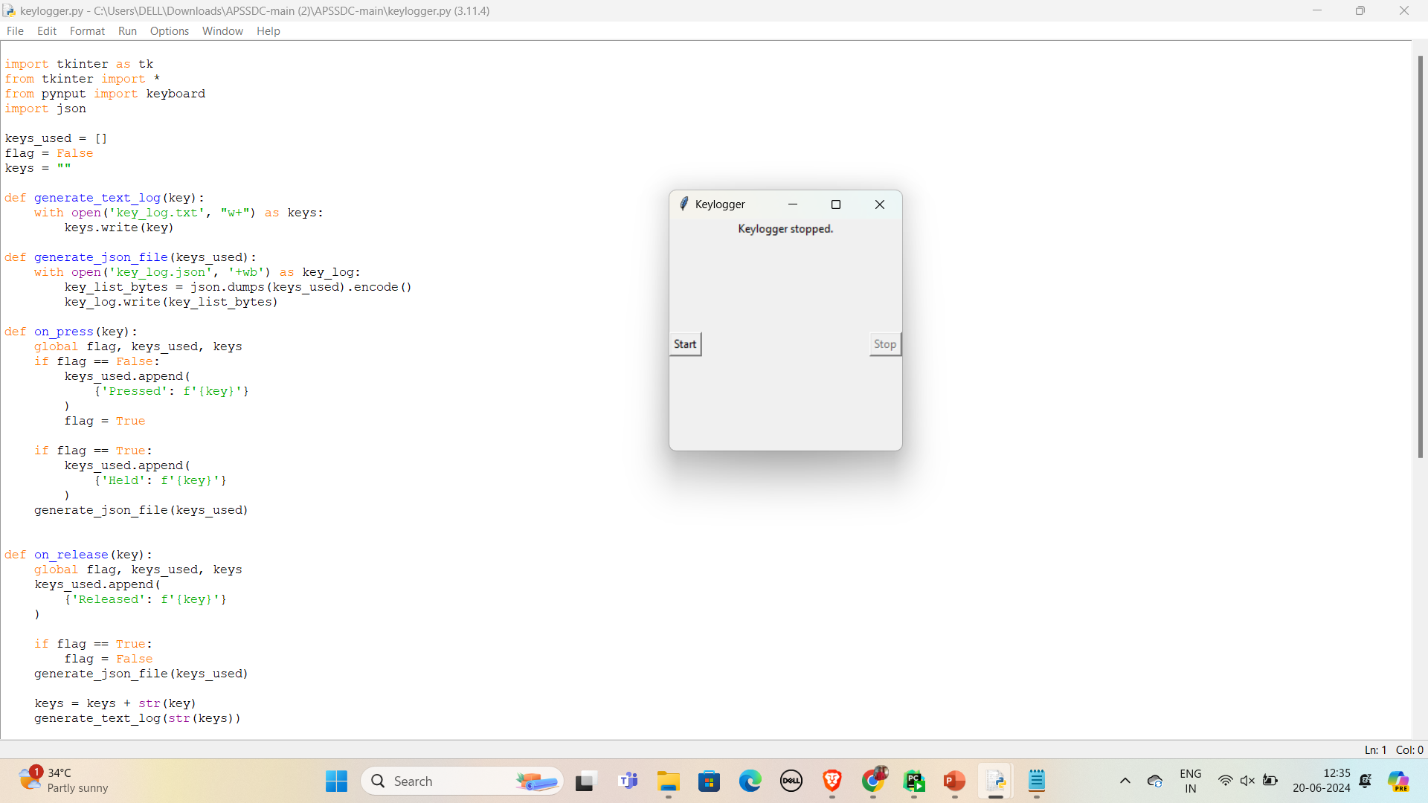

OUTPUTS

Slide 12
GITHUB LINK:
https://github.com/2200032010/APSSDC-Key.git

Slide 13
RESULTS
Enhanced Security Posture: Organizations can achieve a heightened level of protection against keyloggers and other cyber threats, reducing the risk of data breaches, financial losses, and reputational damage.
Improved Compliance: Meeting regulatory requirements and industry standards related to cybersecurity, thereby avoiding potential fines, penalties, and legal liabilities associated with data breaches.

